Slide 1
PROTEIN IDENTIFICATION
lennart martens
lennart.martens@vib-ugent.be
@compomics
computational omics and systems biology group
Ghent University and VIB, Ghent, Belgium

Slide 2
MS/MS spectra and identification
Database search algorithms in three phases
Sequencial search algorithms
Decoys and false discovery rate calculation
The future: machine learning
Protein inference: bad, ugly, and not so good

Slide 3
MS/MS spectra and identification
Database search algorithms in three phases
Sequencial search algorithms
Decoys and false discovery rate calculation
The future: machine learning
Protein inference: bad, ugly, and not so good

Slide 4
Peptides subjected to fragmentation analysis can yield several types of fragment ions
x₃
y₃
z₃
x₂
y₂
z₂
x₁
y₁
z₁
R₁
R₂
R₃
R₄
NH₂
C
H
CO
N
H
C
H
CO
N
H
C
H
CO
N
H
C
H
COOH
a₁
b₁
c₁
a₂
b₂
c₂
a₃
b₃
c₃
There are several other ion types that can be annotated, as well as
‘internal fragments’. The latter are fragments that no longer contain an intact
terminus. These are harder to use for ‘ladder sequencing’, but can still be interpreted.
This nomenclature was coined by Roepstorff and Fohlmann (Biomed. Mass Spec., 1984) and Klaus Biemann (Biomed.
Environ. Mass Spec., 1988) and is commonly referred to as ‘Biemann nomenclature’. Note the link with the Roman alphabet.

Slide 5
In an ideal world, the peptide sequence will produce directly interpretable ion ladders
L E N N A R T
intensity
RT
LENNAR
NART
NNART
LEN
LENNART
LENNA
LENNART
ART
ENNART
T
LENN
L
LE
L
E
N
N
A
R
T
m/z

Slide 6
Real spectra usually look quite a bit worse, which introduces ambiguity in interpretation
N
intensity
LE
/EL
N
NA / AN
[EL]
[EI]
[E[IL]]
[QN]
[KN]
[AN]
[QG]
[KG]
NART
LEN
LENNART
LENNA
LENNART
ART
T
LE
m/z

Slide 7
MS/MS spectra and identification
Database search algorithms in three phases
Sequencial search algorithms
Decoys and false discovery rate calculation
The future: machine learning
Protein inference: bad, ugly, and not so good

Slide 8
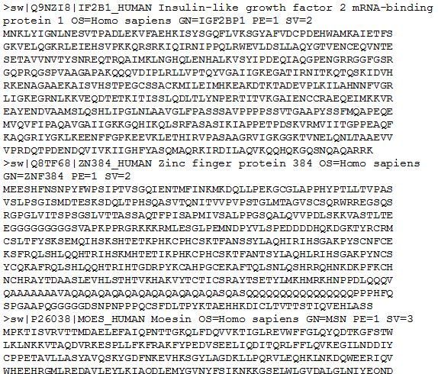
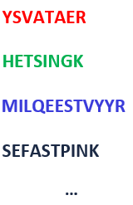
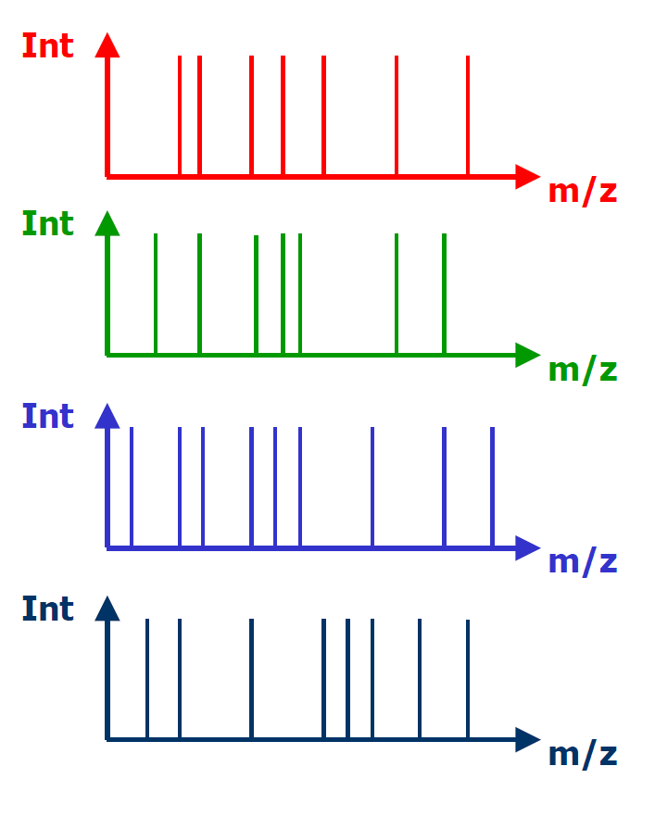
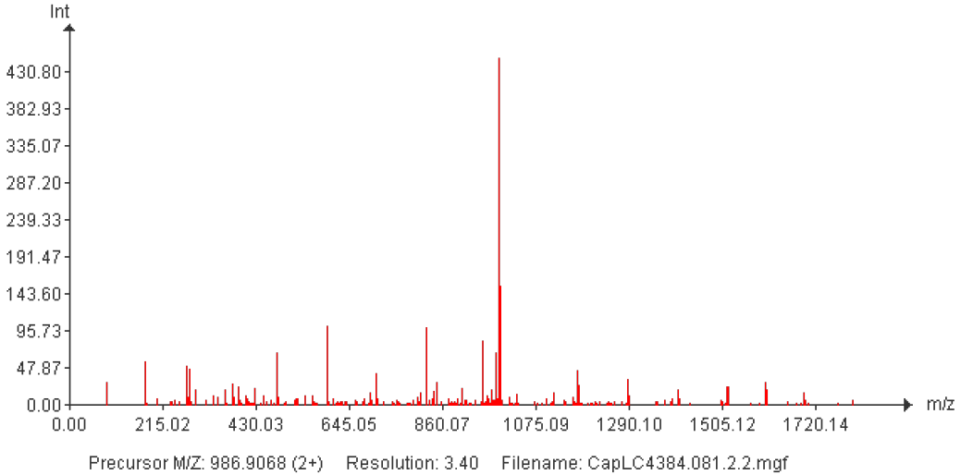
Database search engines match experimental spectra to known peptide sequences
database
peptide seq.
theoretical spectra
peptide scores
1) YSFVATAER 34
2) YSFVSAIR 12
3) FFLIGGGGK 12
…
in silico
digest
in silico
MS/MS
scoring
function
protein inference
experimental spectra

Slide 9
Three popular algorithms illustrate the three types of scoring systems
SEQUEST (UWashington, Thermo Fisher Scientific)
Intensity-based scoring system
MASCOT (Matrix Science) / Andromeda (Jürgen Cox)
Peak counting-based scoring system
X!Tandem (The Global Proteome Machine Organization)
Hybrid scoring system

Slide 10
SEQUEST is the original search engine, and is based on ion intensity matching
Can be used for MS/MS (PFF) identifications
Based on a cross-correlation score (includes peak height)
Published core algorithm (patented, licensed to Thermo), Eng, JASMS 1994
Provides preliminary (Sp) score, rank, cross-correlation score (XCorr),
and score difference between the top tow ranks (deltaCn, ΔCn)
Thresholding is up to the user, and is commonly done per charge state
Many extensions exist to perform a more automatic validation of results

Slide 11

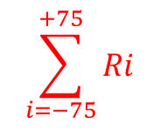
The correlation score (R_{i}) is calculated as the matched ion intensity
$$\sum_{i=−75}^{+75}{Ri}$$
Int
R₂
m/z
Int
$$R_{i}= \sum_{j=1}^{n}{x_{j}{∙y}_{(j+i)}}$$
R₁
m/z
Int
R₀
m/z
Int
R₋₁
m/z
Int
R₋₂
Eng, JASMS 1994
Yılmaz, Proteome Bioinformatics (MMB), Springer, 2017
m/z

Slide 12
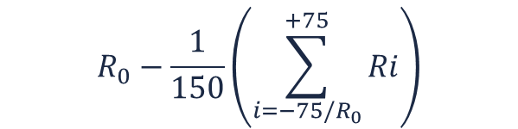
The cross-correlation score (Xcorr) is R₀ calibrated by the average random correlation
$$R_{0}−\frac{1}{150}\left(\sum_{i=−75/R_{0}}^{+75}{Ri}\right)$$
XCorr =
Frequency
[R₋₇₅, R₇₅]
/R₀
R₀
correlation
score
Eng, JASMS 1994
Yılmaz, Proteome Bioinformatics (MMB), Springer, 2017

Slide 13
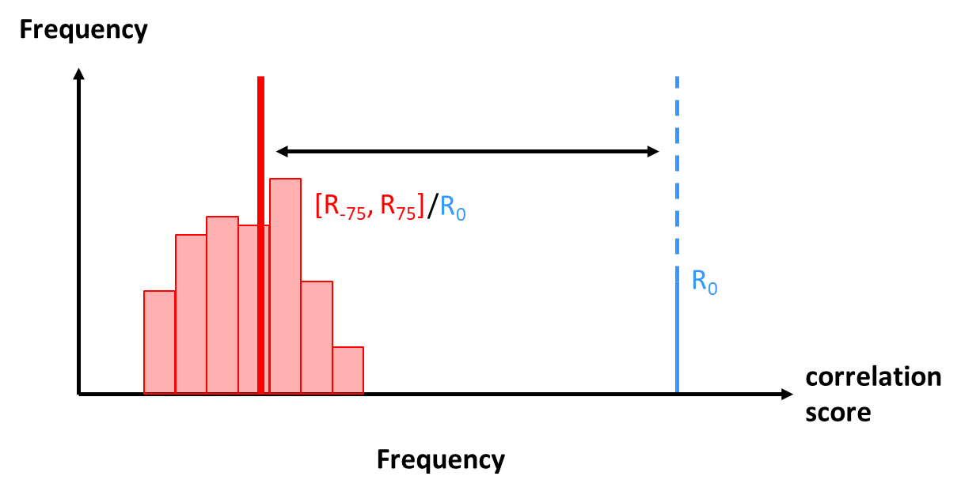
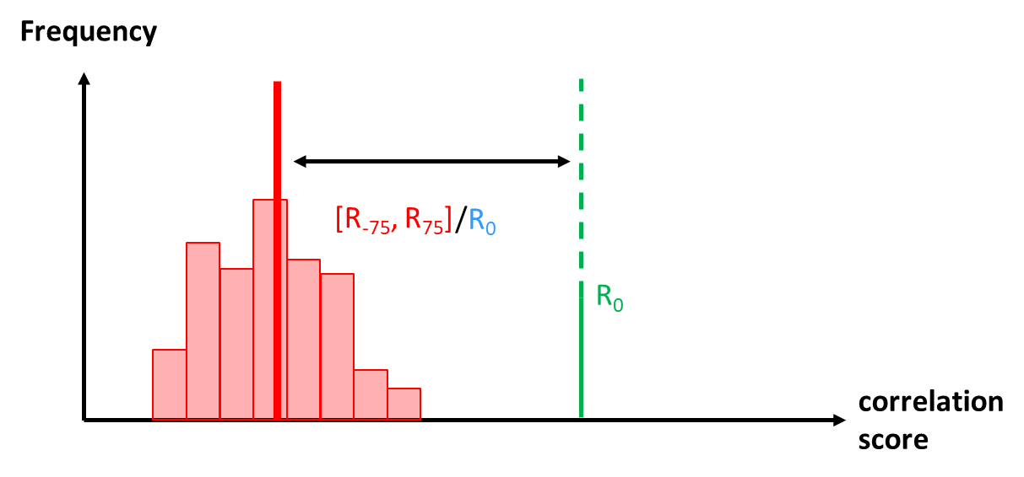
The best theoretical match is then compared to the second-best theoretical match
deltaCn =
XCorr₁
XCorr₂
Int
Int
m/z
m/z
Eng, JASMS 1994
Yılmaz, Proteome Bioinformatics (MMB), Springer, 2017

Slide 14
Mascot is an equally recognized search engine, but is based on peak counting
Very well established search engine, Perkins, Electrophoresis 1999
Can do MS (PMF) and MS/MS (PFF) identifications
Based on the MOWSE score,
Unpublished core algorithm (trade secret)
Predicts an a priori threshold score that identifications need to pass
From version 2.2, Mascot allows integrated decoy searches
Provides rank, score, threshold and expectation value per identification
Customizable confidence level for the threshold score

Slide 15
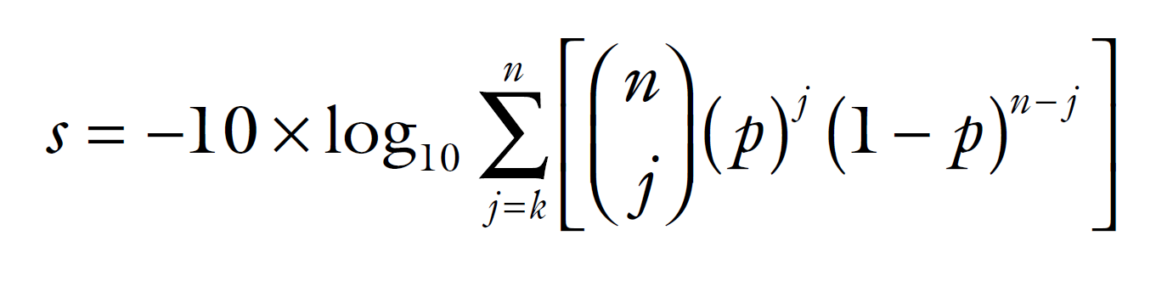
Through Andromeda, we understand MASCOT
n = number of theoretical peaks
k = number of matched peaks (within a given fragment tolerance)
p = probability of finding a single, matched peak by chance
p is calculated by dividing the number of highest intensity peaks (q) by a mass-window size (100 Da)
q is limited by a maximum value, and is optimized for maximum s
based on peak counting instead of intensity sums
Cox, J Prot Res, 2011
Yılmaz, Proteome Bioinformatics (MMB), Springer, 2017

Slide 16
X!Tandem introduces a hybrid score, based on both peak counting and ion intensity
A successful open source search engine, Craig and Beavis, RCMS 2003
Can be used for MS/MS (PFF) identifications
Based on a hyperscore (Pi is either 0 or 1):
Relies on a hypergeometric distribution (hence hyperscore)
Published core algorithm, and is freely available
Provides hyperscore and expectancy score (the discriminating one)
X!Tandem is fast and can handle modifications in an iterative fashion
Has rapidly gained popularity as (auxiliary) search engine

Slide 17
X!Tandem’s significance calculation for scores can be seen as a general template
# results
log(# results)
hyperscore
hyperscore
significance
threshold
log(# results)
E-value=e^{-8.2}
Adapted from: Brian Searle, ProteomeSoftware,
http://www.proteomesoftware.com/XTandem_edited.pdf
hyperscore

Slide 18
MS/MS spectra and identification
Database search algorithms in three phases
Sequencial search algorithms
Decoys and false discovery rate calculation
The future: machine learning
Protein inference: bad, ugly, and not so good

Slide 19
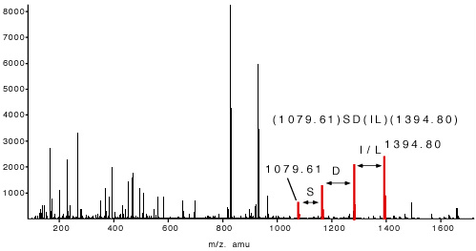
Sequence tags are as old as SEQUEST, and still have a role to play today
sequence tag
1079.61 - SD[IL] - 303.20
The concept of sequence tags was introduced by Mann and Wilm
Mann, Analytical Chemistry, 1994

Slide 20
GutenTag, DirecTag, TagRecon
Tabb, Anal. Chem. 2003, Tabb, JPR 2008, Dasari, JPR 2010
Recent implementations of the sequence tag approach
Refine hits by peak mapping in a second stage to resolve ambiguities
Rely on a empirical fragmentation model
Published core algorithms, DirecTag and TagRecon freely available
GutenTag/DirecTag extracts tags, TagRecon matches tags to database
Very useful to retrieve unexpected peptides (modifications, variations)
Entire workflows exist (e.g., combination with IDPicker)

Slide 21
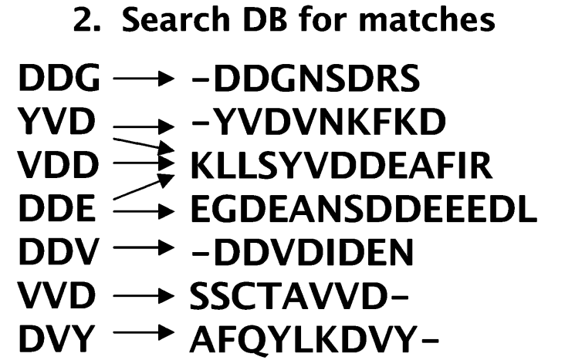
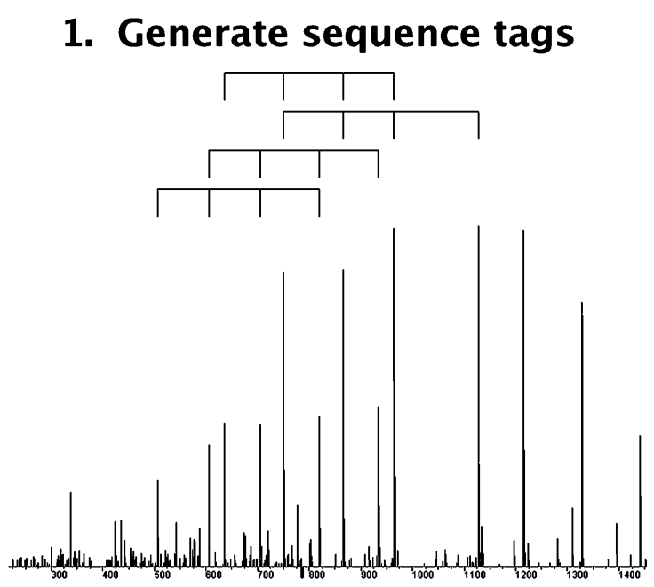
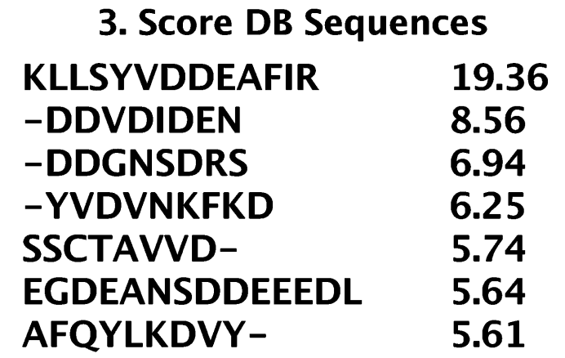
GutenTag: two stage, hybrid tag searching
Tabb, Analytical Chemistry, 2003

Slide 22
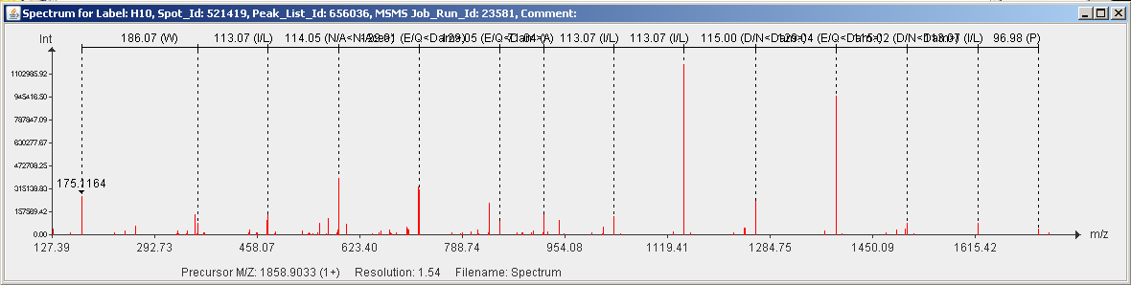
De novo sequencing tries to read the entire peptide sequence from the spectrum
Example of a manual de novo of an MS/MS spectrum
No more database necessary to extract a sequence!
Algorithms
Lutefisk
Sherenga
PEAKS
PepNovo
RapidNovor
…
References
Dancik 1999, Taylor 2000
Fernandez-de-Cossio 2000
Ma 2003, Zhang 2004
Frank 2005, Grossmann 2005
Ma 2015
…

Slide 23
MS/MS spectra and identification
Database search algorithms in three phases
Sequencial search algorithms
Decoys and false discovery rate calculation
The future: machine learning
Protein inference: bad, ugly, and not so good

Slide 24
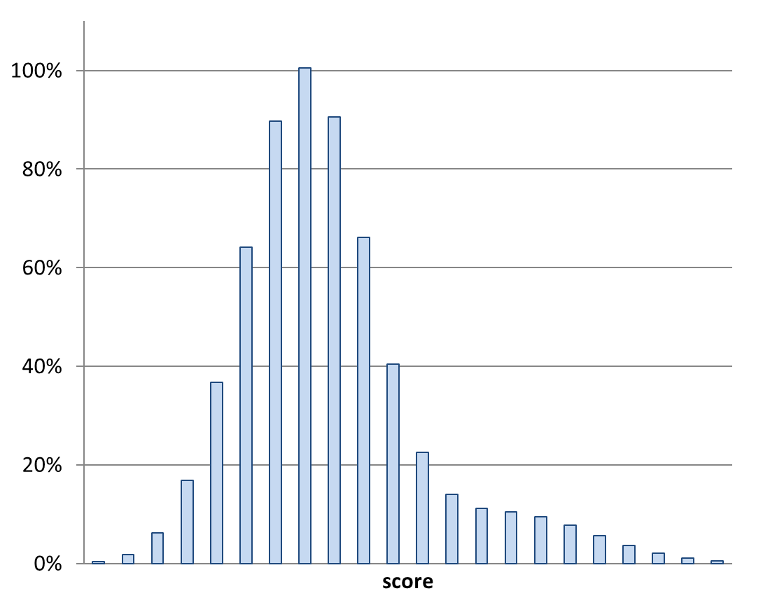

All hits, good and bad together, form a distribution of scores
Nesvizhskii, J Proteomics, 2010

Slide 25
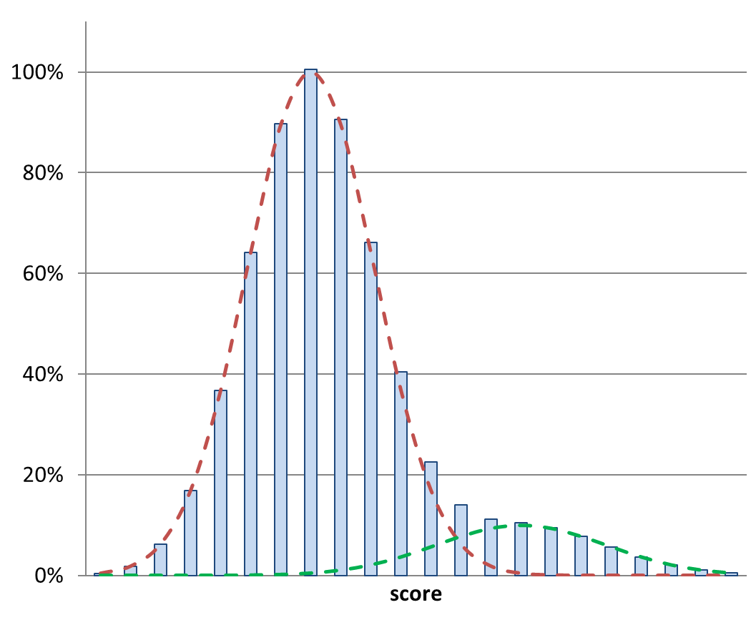


If we know how scores for bad hits distribute, we can distinguish good from bad by score

Slide 26
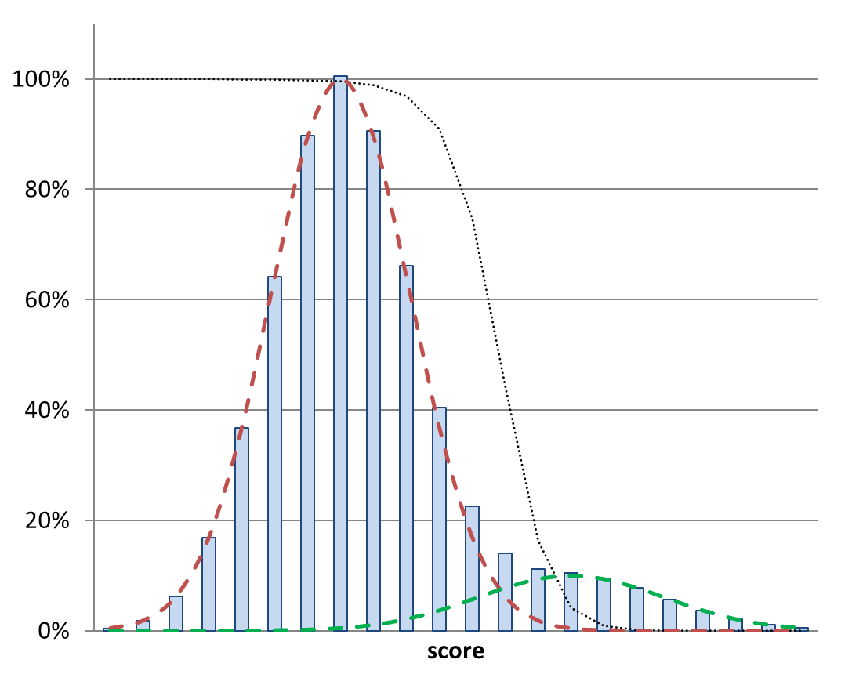
The separation is not perfect, which leads to the calculation of a local false discovery rate
local false discovery rate
(posterior error probability; PEP)

Slide 27
Decoy databases are false positive factories, assumed to deliver representative bad hits
Three main types of decoy DB’s are used:
- Reversed databases (easy)
LENNARTMARTENS → SNETRAMTRANNEL
- Shuffled databases (slightly more difficult)
LENNARTMARTENS → NMERLANATERTTN (for instance)
- Randomized databases (as difficult as you want it to be)
LENNARTMARTENS → GFVLAEPHSEAITK (for instance)
The concept is that each peptide identified from the decoy database is an incorrect identification. By counting the number of decoy hits, we can estimate the number of false positives in the original database, provided that the decoys have similar properties as the forward sequences.

Slide 28
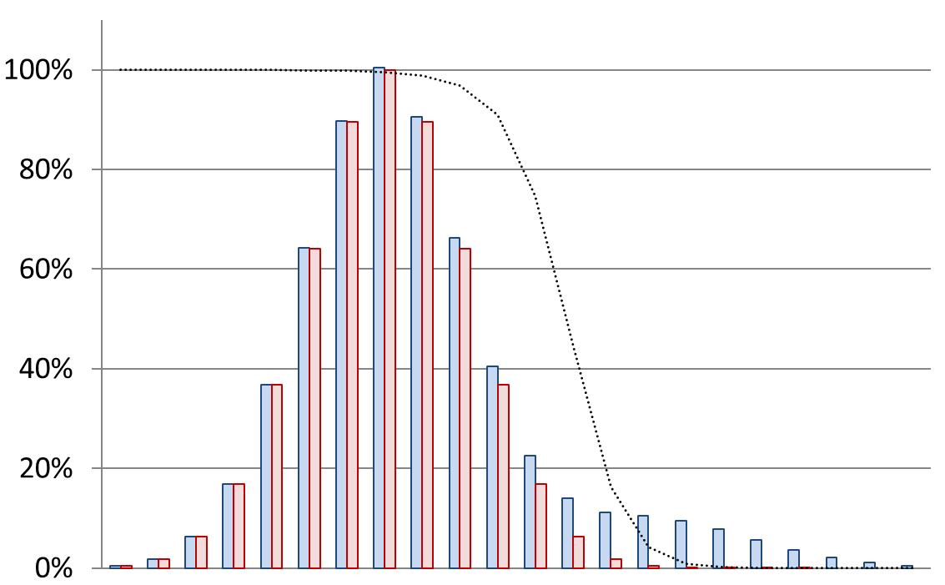


With the help of the scores of decoy hits, we can assess the score distribution of bad hits
local false discovery rate
(posterior error probability; PEP)
score
Käll, Journal of Proteome Research, 2008

Slide 29
MS/MS spectra and identification
Database search algorithms in three phases
Sequencial search algorithms
Decoys and false discovery rate calculation
The future: machine learning
Protein inference: bad, ugly, and not so good

Slide 30
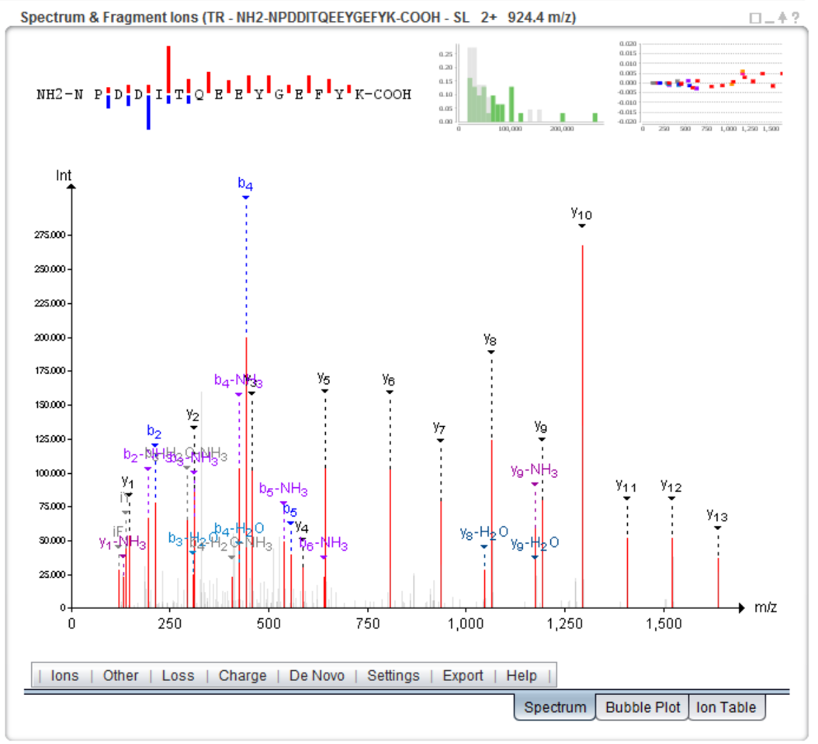
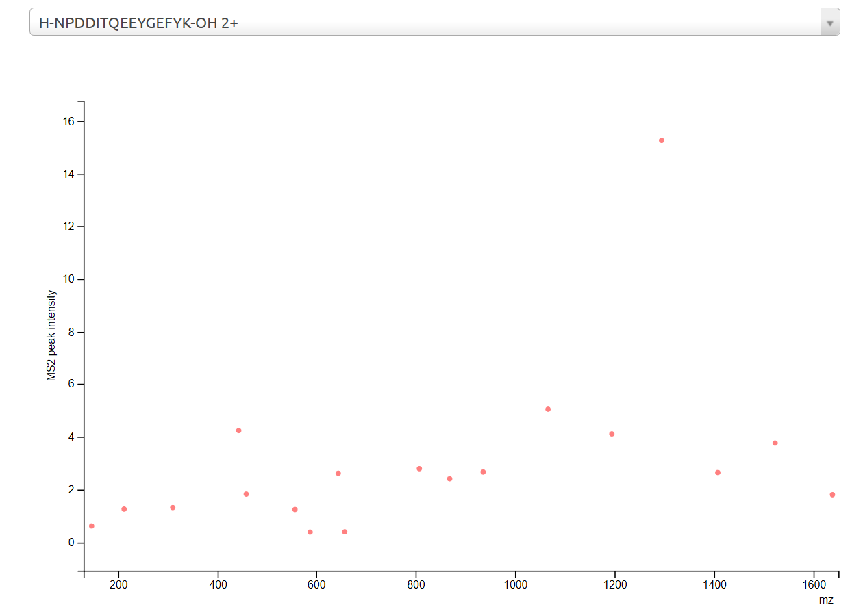
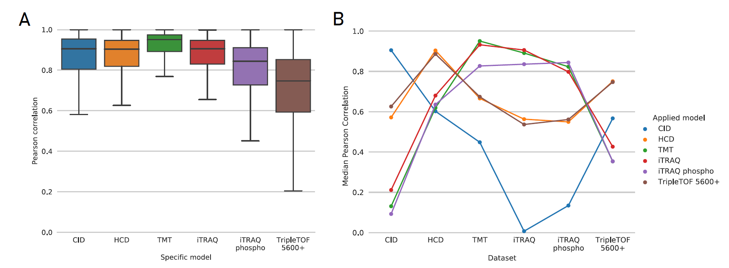
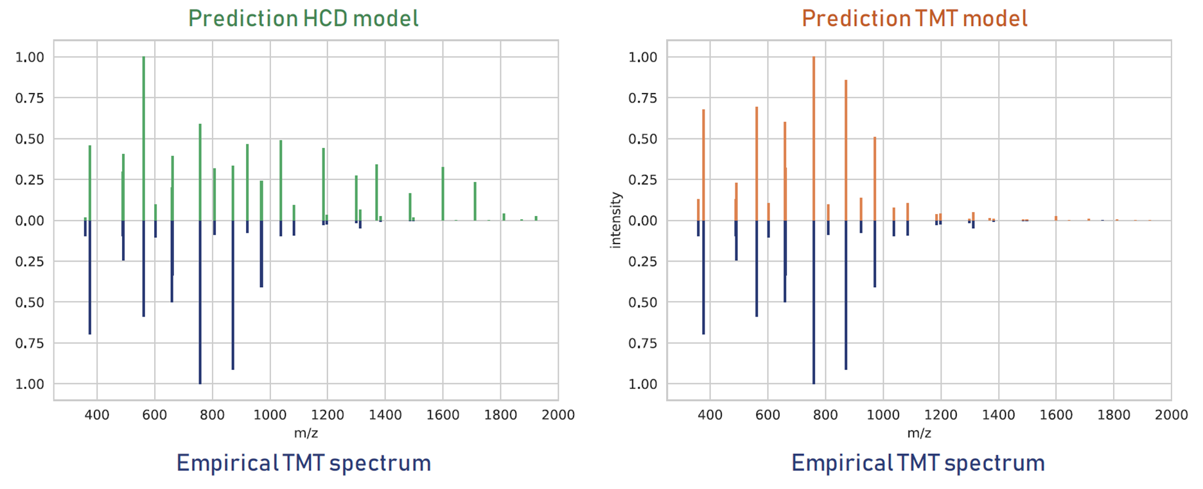
Our MS2PIP fragmentation model accurately predicts peptide fragmentation behaviour
https://iomics.ugent.be/ms2pip
Degroeve, Bioinformatics, 2013
Degroeve, Nucleic Acids Research, 2015
Vaudel, Nat. Biotech., 2015
PeptideShaker
https://iomics.ugent.be/ms2pip/
Gabriels, Nucleic Acids Research, 2019

Slide 31
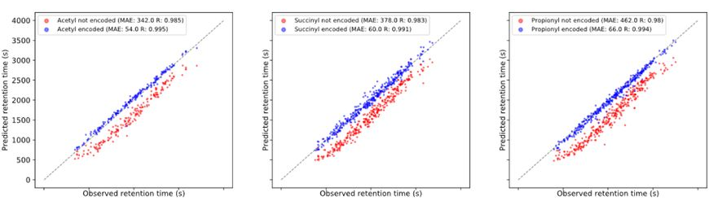
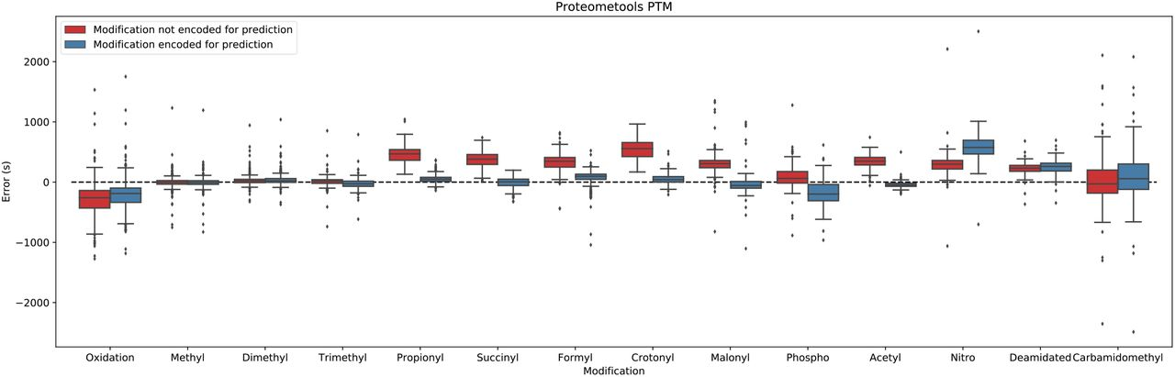
Our DeepLC model accurately predicts retention times of peptides with unseen modifications
acetylation
succinylation
propionylation
DeepLC prediction
Traditional prediction
Traditional prediction
DeepLC prediction
31
Dataset from Zolg, MCP, 2018
Bouwmeester, Nature Methods, 2021

Slide 32
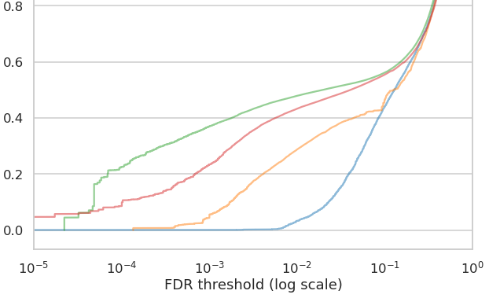
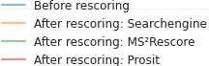
MS2PIP and DeepLC in MS²Rescore dramatically boost identification in immunopeptidomics
IDed spectra (100k)
0.1% FDR
1% FDR
more IDed
spectra
+ MS²PIP
& DeepLC
+ MS²PIP
& DeepLC
Percolator
https://github.com/compomics/ms2rescore
Declercq, MCP, 2022
more stringent FDR threshold

Slide 33
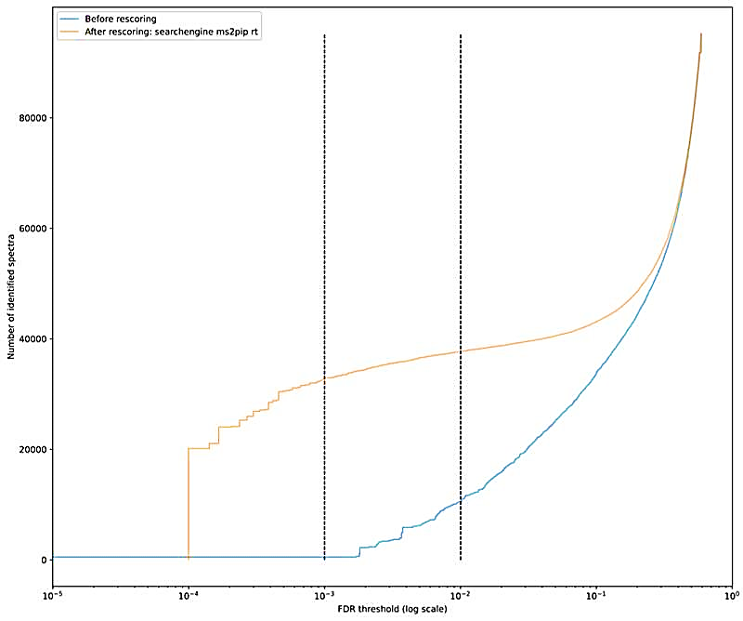
MS²Rescore can also be applied to generic peptidomics data
# IDed spectra
0.1% FDR
1% FDR
80k
60k
MS²ReScore
40k
MaxQuant
20k
0
https://github.com/compomics/ms2rescore
FDR threshold (log scale)

Slide 34
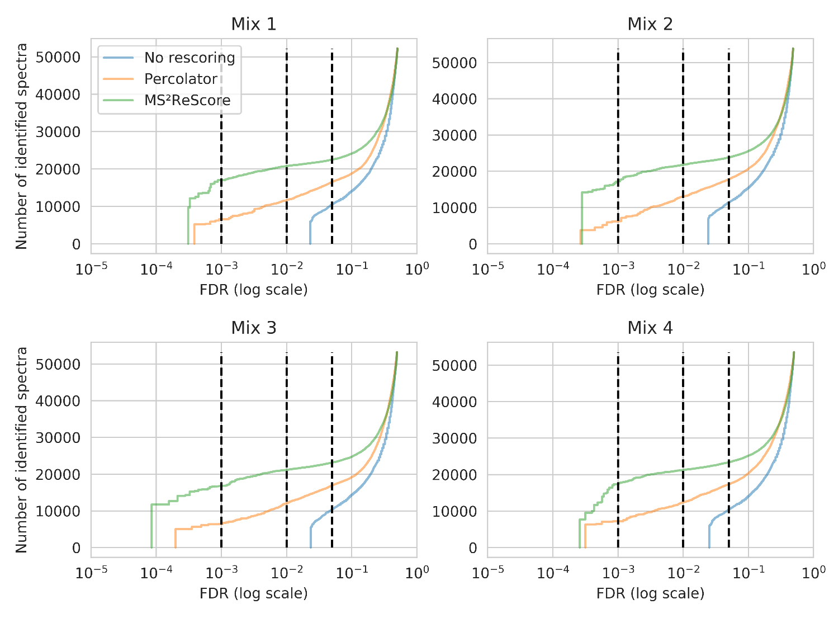
MS²Rescore also boosts metaproteomics, opening up the prospect of meta-immunopeptidomics
Van Den Bossche et al., in preparation

Slide 35



MS2PIP and DeepLC power ionbot, a novel open modification search engine with high reliability
improved ML-based algorithms
…
ML models
predictions
fully machine learning-based scoring
sensitive and highly accurate
identification of (modified) peptides
https://ionbot.cloud
Degroeve, https://www.biorxiv.org/content/10.1101/2021.07.02.450686v2

Slide 36
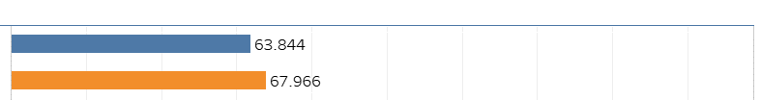
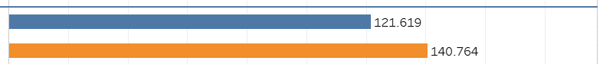
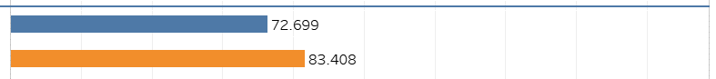
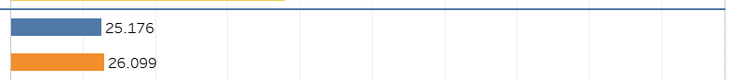
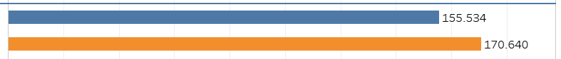
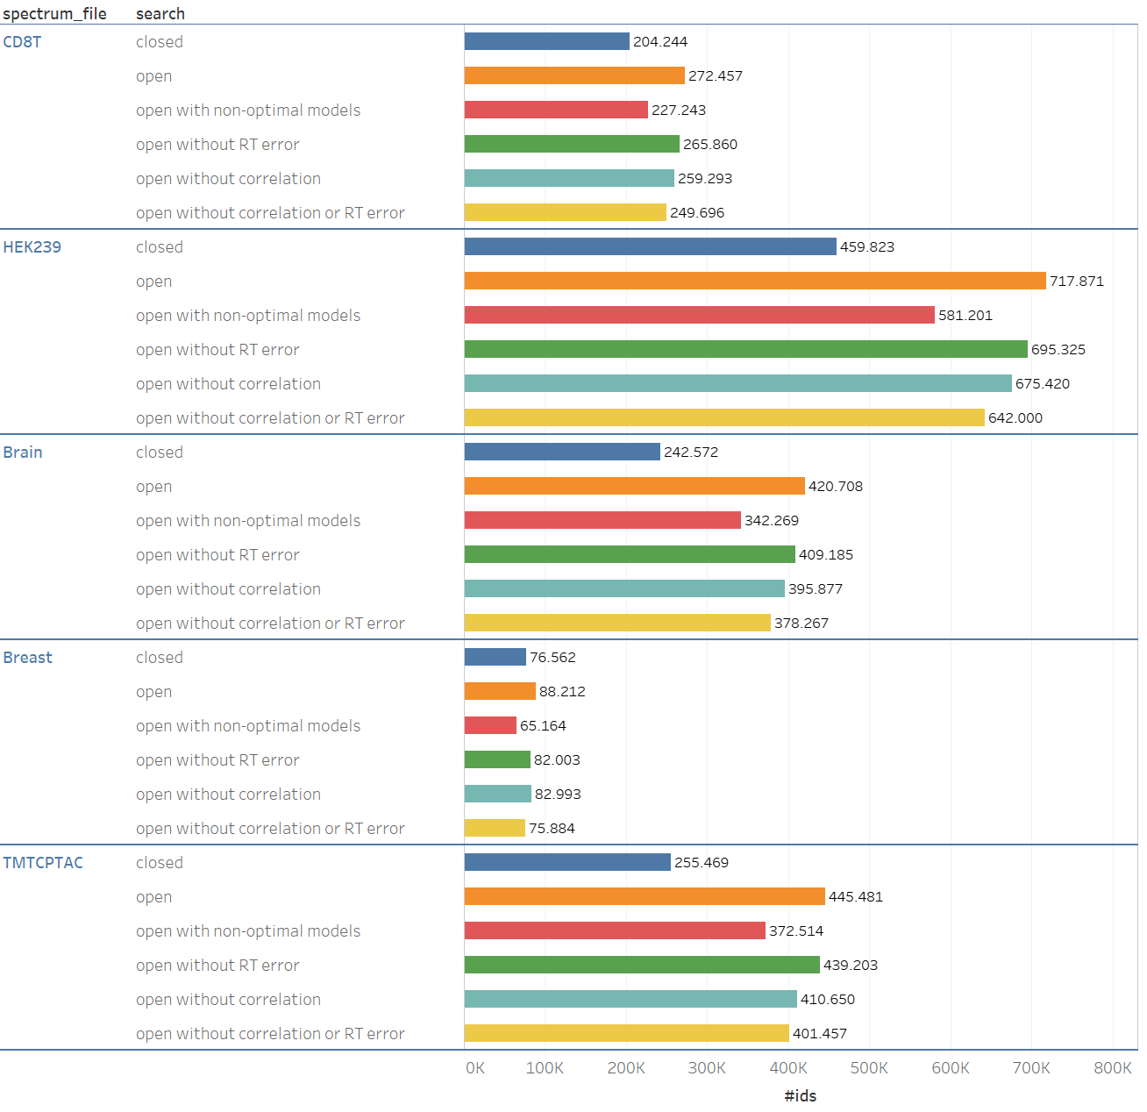
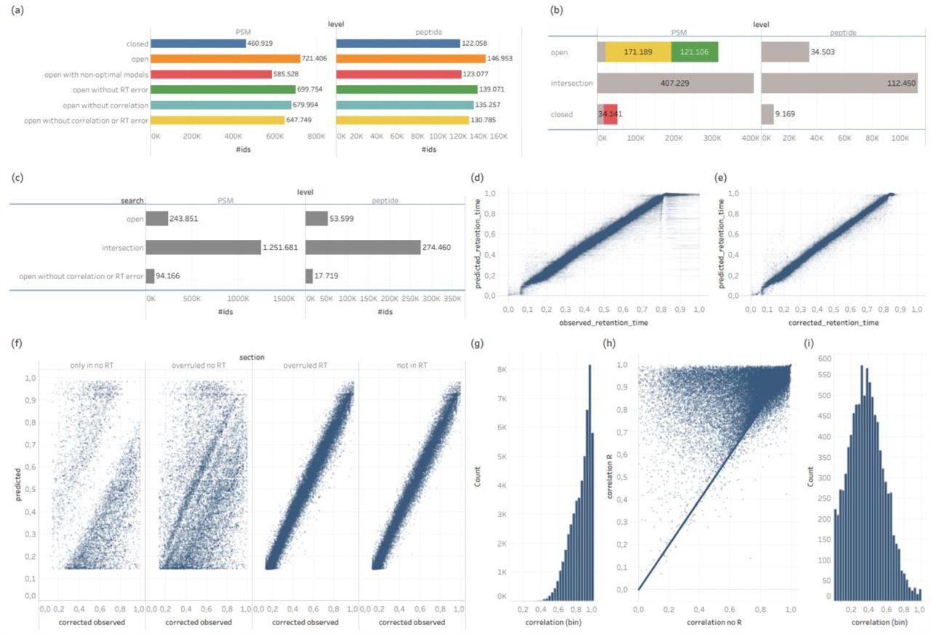
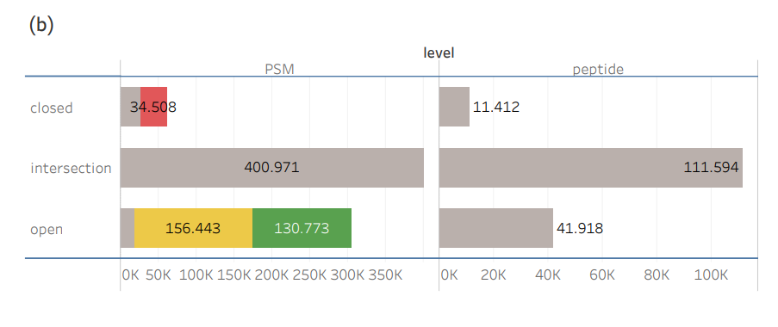
ionbot shows the value of open modification searches, and of accurate prediction models
PSMs
peptides
https://ionbot.cloud
Degroeve, https://www.biorxiv.org/content/10.1101/2021.07.02.450686v2

Slide 37
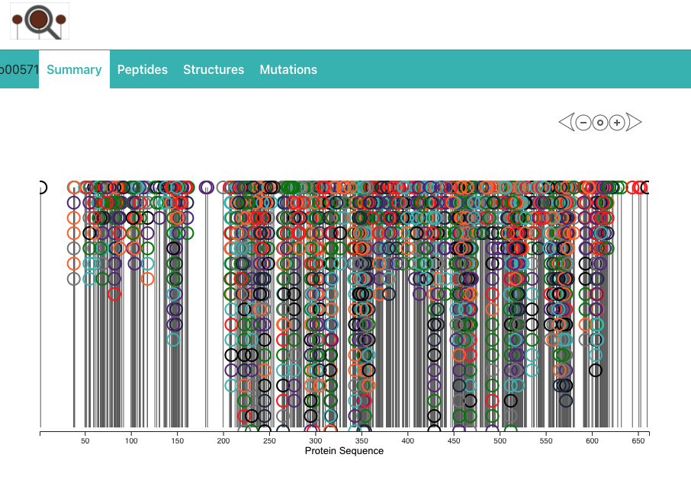
When all PTMs are considered, our view of proteins is changed

Slide 38
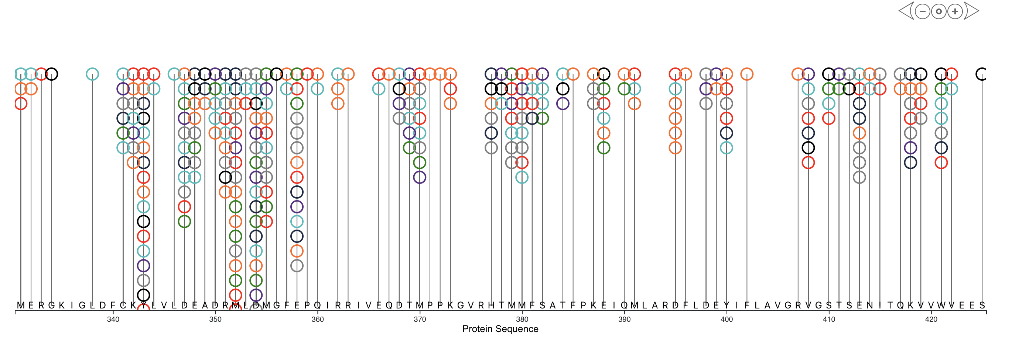
Zooming in shows that not all residues are created equal

Slide 39
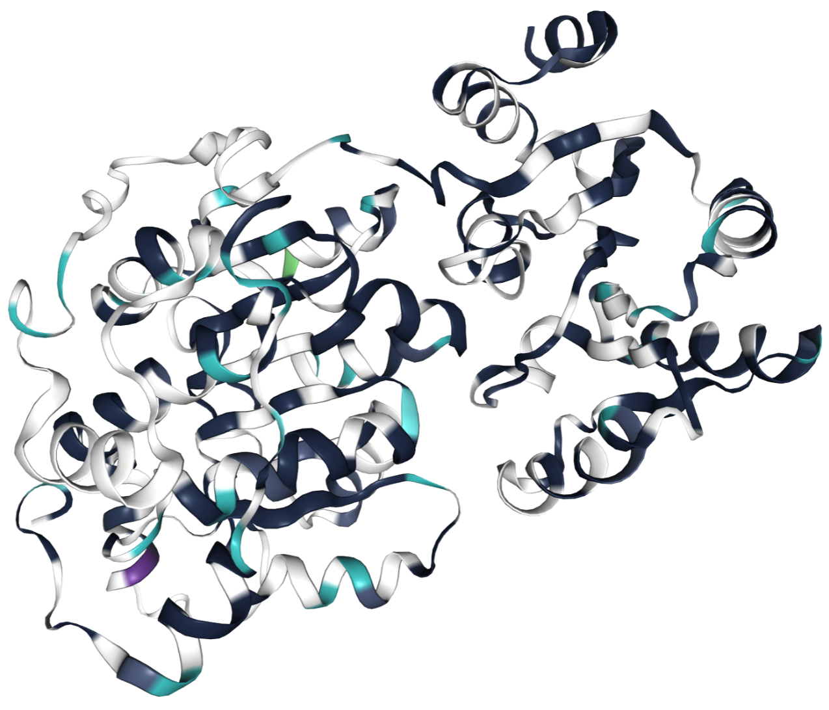
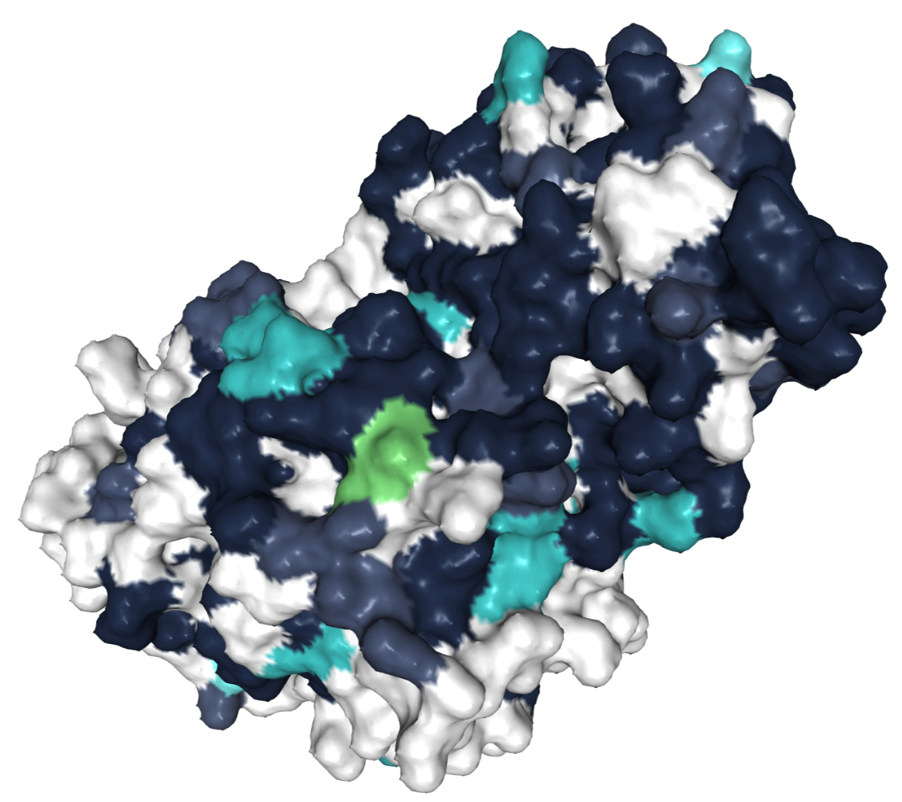
The 3D structure view also becomes rather crowded

Slide 40
MS/MS spectra and identification
Database search algorithms in three phases
Sequencial search algorithms
Decoys and false discovery rate calculation
The future: machine learning
Protein inference: bad, ugly, and not so good

Slide 41
Protein inference is a question of conviction
peptides a b c d
proteins
prot X x x
prot Y x
prot Z x x x
{
Minimal set
Occam
peptides a b c d
proteins
prot X x x
prot Y x
prot Z x x x
{
Maximal set
anti-Occam
peptides a b c d
proteins
prot X(-) x x
prot Y(+) x
prot Z(0) x x x
{
Minimal set with
maximal annotation
true Occam?
Martens, Molecular Biosystems, 2007

Slide 42
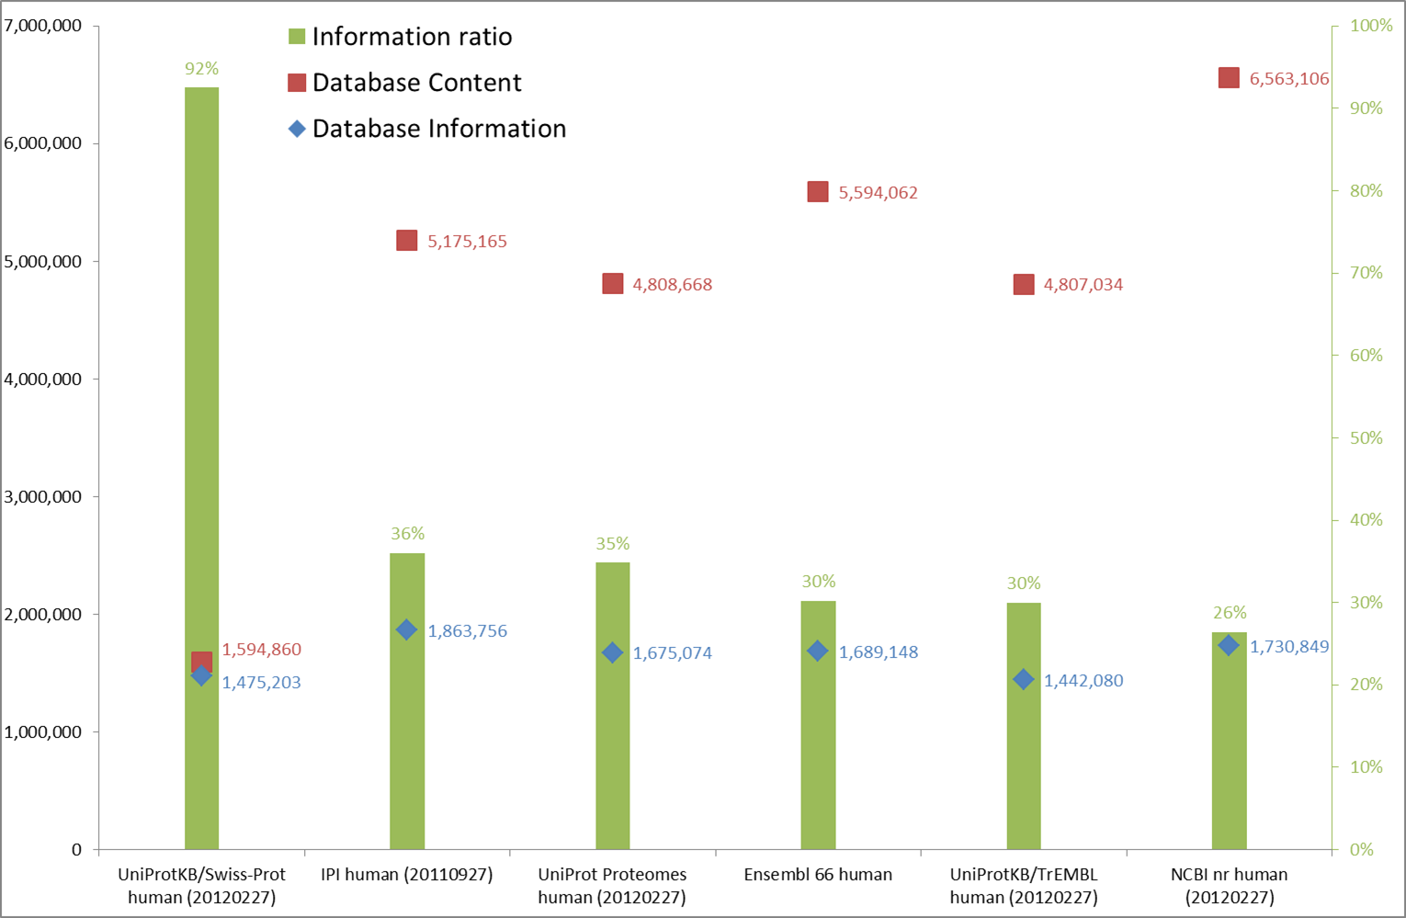
The complexity of protein inference is linked to the information ratio of a database
Tryptic cleavage, 1 allowed missed cleavage,
Mass limits from 600 to 4000 Da.
Barsnes, Amino Acids, 2013

Slide 43
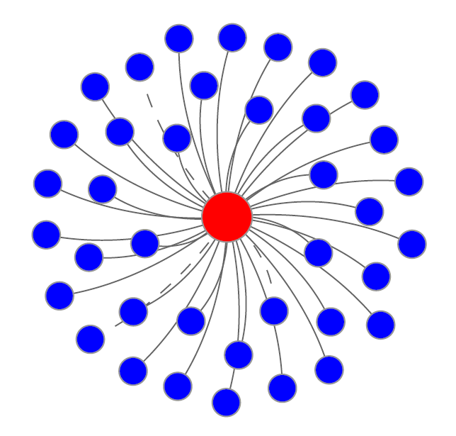
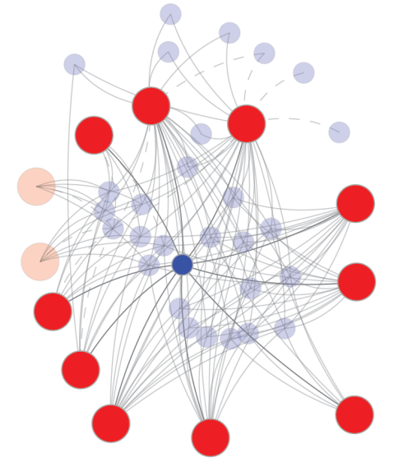
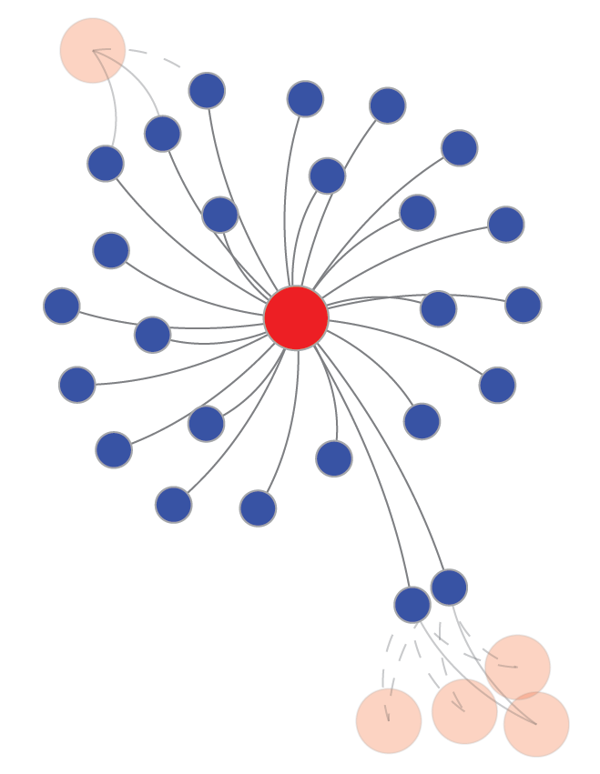
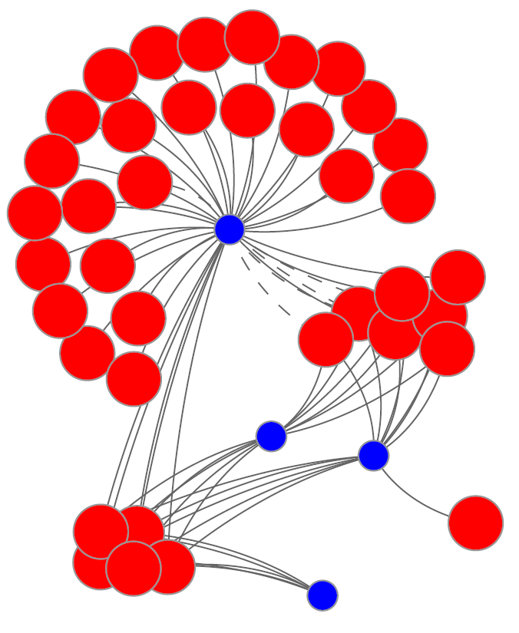
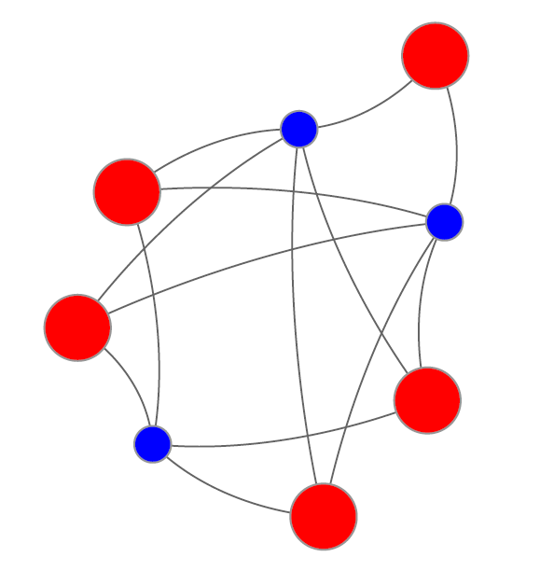
In real life, protein inference issues will be mainly bad, often ugly, and occasionally good

Slide 44
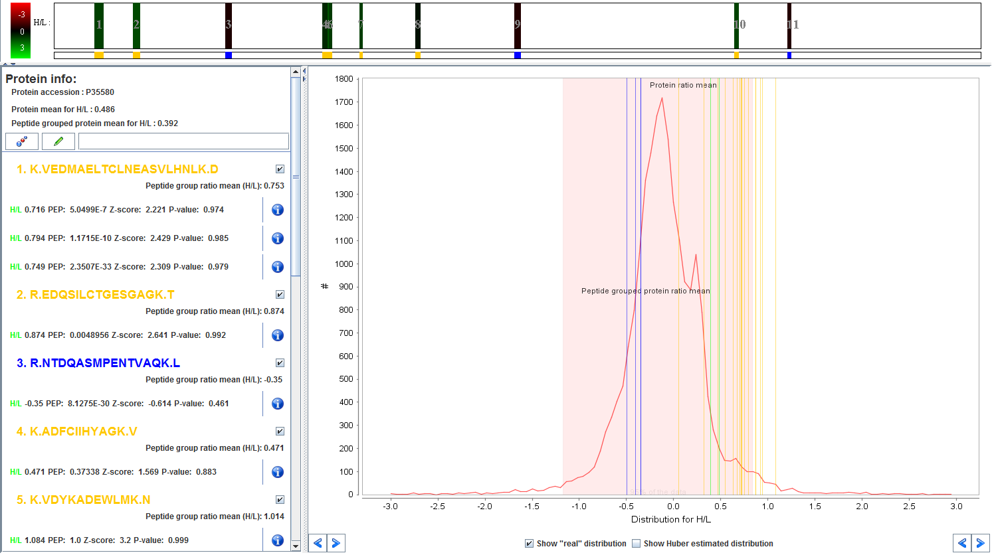
Protein inference can create issues in quantification due to degenerate peptides
A nice example of the mess of degenerate peptides in quantification
Colaert, Proteomics, 2010

